Slide 1
Photographer research assignment
Loren wehrley

Slide 2
Terry Richardson
Date of Birth: August 14, 1965
Birthplace: New York City, New York
Terry is not dead. He is still photographing
Medium used in his art: Digital
Favorite Subject Matter: Fashion Photography and photos of celebrities
Route to becoming a photographer: Terry grew up in Hollywood, Los Angeles attending high school and participating in band. His interests in high school led him to taking photography lessons; soon developing a passion for photography. He was shy, but he felt like he could show creativity through his photos. Before becoming a professional photographer, he was a photographer assistant with Tony Kent(well-known photographer and friends with his mom).
Techniques: He uses white background and bright lights in his photos.
Best known photos: Photos of celebrities

Slide 3
Impact on society
The photographs that Terry Richardson takes has a large impact on society. The way he takes his photos are different compared to other photographers. The background in his photos is always plain. And since his photos display a lot of negativity, people always look at him as a bad person. He is a very unique photographer and has a lot of pride in the photographs that he takes.

Slide 4
References
https://laurentasg2.wordpress.com
Famous-photographers.com/terry-richardson/
www.fanpop.com

Slide 5
Personal Reflection
I chose this photographer because his photographs are very unique. Before this project I wasn’t really sure who he was and after I looked at some of his photos he seemed like a very interesting photographer. I love the way he uses the bright lighting and colors that pop. He adds a twist to the photos he takes that some photographers don’t use.

Slide 6
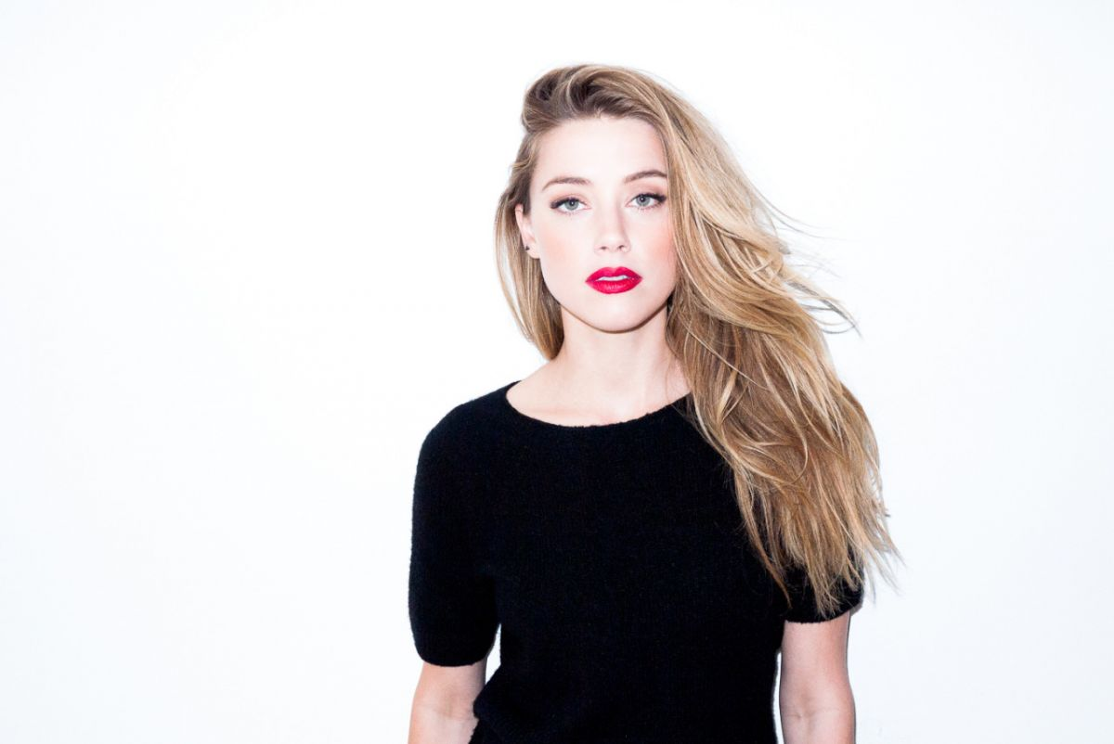
Amber heard

Slide 7
Cara Delevingne

Slide 8
Lindsey wixson

Slide 9
Kate moss

Slide 10
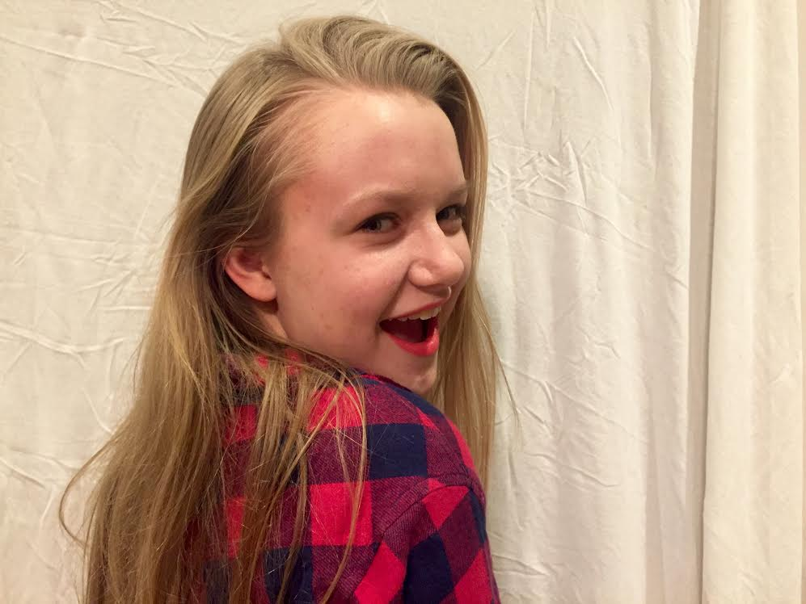
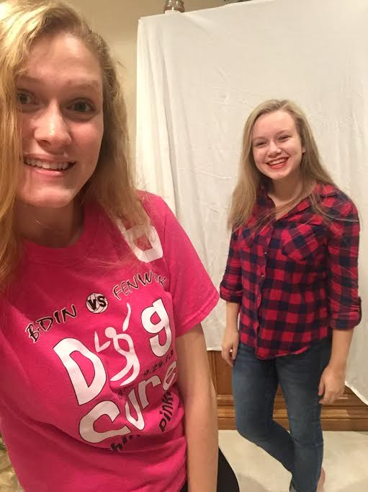
Recreation
Amber Heard- Terry Richardson

Slide 11
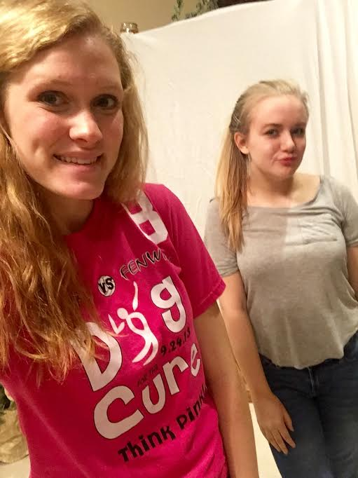
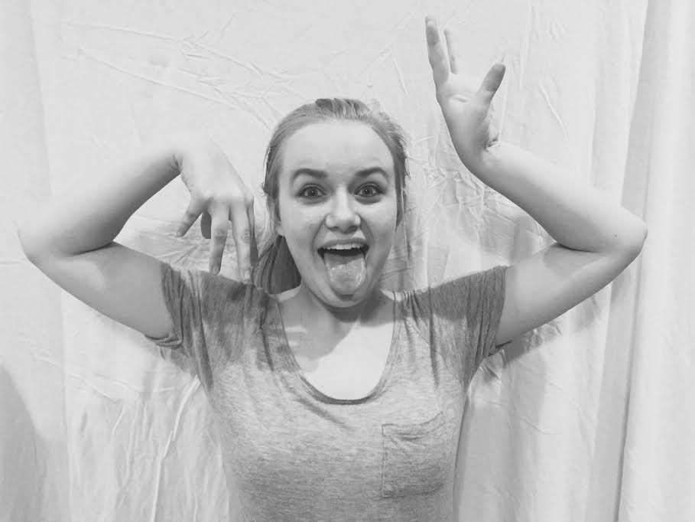
RECREATION
Cara Delevingne- Terry Richardson

